Slide 1
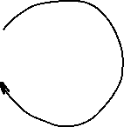
A biased example
Start
S = GGCACTGAA
Log probability that the second G
was emitted by state C:
Log probability that the second G
was emitted by state N:
-1
-1
C
A -2.322
C -1.737
G -1.737
T -2.322
N
A -1.737
C -2.322
G -2.322
T -1.737
-inf
0
0
-inf
$$p_{C}\left(G,2\right)=−1.737+\max\left(p_{C}\left(G,1\right)+p_{CC},p_{N}\left(G,1\right)+p_{NC}\right)=−4.474$$
-2.737
-inf
$$p_{N}\left(G,2\right)=−2.322+\max\left(p_{C}\left(G,1\right)+p_{CN},p_{N}\left(G,1\right)+p_{NN}\right)=−5.644$$
-inf
-3.322

Slide 2
A biased example
Start
S = GGCACTGAA
Iteratively compute probabilities, record values and where you came from in two matrices (arrays):
-1
-1
C
A -2.322
C -1.737
G -1.737
T -2.322
N
A -1.737
C -2.322
G -2.322
T -1.737
-inf
0
0
-inf
 | G | G | C | A | C | T | G | A | A
C | -2.73 | -4.47
N | -3.32 | -5.64

Slide 3
A biased example
Start
S = GGCACTGAA
Iteratively compute probabilities, record values and where you came from in two matrices (arrays):
-1
-1
C
A -2.322
C -1.737
G -1.737
T -2.322
N
A -1.737
C -2.322
G -2.322
T -1.737
-inf
0
0
-inf
 | G | G | C | A | C | T | G | A | A
C | -2.73 | -4.47 | -6.20 | -8.52 | -10.26 | -12.59 | -14.32 | -16.64 | -18.97
N | -3.32 | -5.64 | -7.97 | -9.70 | -12.03 | -13.77 | -16.08 | -17.82 | -19.56

Slide 4
A biased example
Start
S = GGCACTGAA
Iteratively compute probabilities, record values and where you came from in two matrices (arrays):
-1
-1
C
A -2.322
C -1.737
G -1.737
T -2.322
N
A -1.737
C -2.322
G -2.322
T -1.737
-inf
0
0
-inf
 | G | G | C | A | C | T | G | A | A
C | -2.73 | -4.47 | -6.20 | -8.52 | -10.26 | -12.59 | -14.32 | -16.64 | -18.97
N | -3.32 | -5.64 | -7.97 | -9.70 | -12.03 | -13.77 | -16.08 | -17.82 | -19.56

Slide 5
The Viterbi algorithm: summary
The Viterbi algorithm is used to compute the most probable path (as well as its probability). It requires knowledge of the parameters of the HMM model and a particular output sequence and it finds the state sequence that is most likely to have generated that output sequence.
It works by finding a maximum over all possible state sequences.
In sequence analysis, this method can be used for example to predict coding vs non-­coding sequences.
Similar (in spirit) to Smith-Waterman alignment!

Slide 6
Making use of annotated genomes
We assembled and annotated a reference genome:
  We know the DNA sequence of the genome
  We know positions of all functional elements: exons, introns, transcript and protein coding sequences
How can we use this information:
  We can establish the function of genes by protein homology
  We can relate genotype to phenotype by looking at a population of individuals and by cataloguing their:
    Phenotypes: physical appearance, etc
    Genotypes: set of differences between their genome and the reference

Slide 7
Genome Wide Association Study
A genome-wide association study (GWAS) is a method used to identify genetic variants, that are associated with a particular disease or trait by comparing the genomes of many individuals.
It involves comparing the entire genomes of people who have a disease with those who don't, looking for genetic differences that appear more frequently in the affected group. The results help scientists understand the genetic basis of diseases and other traits.

Slide 8
How GWAS works
Participant groups: Researchers assemble two large groups of people: a "case" group with a specific disease or trait and a "control" group without it.
DNA collection: DNA is collected from all participants, often through a blood sample or a cheek swab.
Genotyping: The DNA is then analyzed to identify common genetic variants, typically single nucleotide polymorphisms (SNPs), across the entire genome.
Association testing: Statistical tests are performed to see if any particular SNP variant is found significantly more often in one group than the other. For example, more people with heart disease might have a "C" SNP in a specific gene compared to a "T" SNP, which is more common in the control group.
Interpretation: Variants found more frequently in the case group are considered to be associated with the disease or trait.

Slide 9
What is GWAS used for
Understanding disease: GWAS provides a way to identify genetic risk factors for many diseases, including some types of cancer, heart disease, and neurological disorders.
Improving research: By pinpointing these associated variants, researchers can investigate the specific genes and biological mechanisms that contribute to disease risk.
Developing treatments: Insights from GWAS can serve as a first step toward understanding a disease's underlying causes and eventually lead to the development of new treatments.

Slide 10
The first step in GWAS: Variant Calling
Sequencing: A DNA sample is sequenced to generate many short reads containing genetic information.
Alignment: The generated short reads are aligned (mapped) to a known reference genome.
Variant Identification: Bioinformatic algorithms compare the aligned reads to the reference to identify positions where they differ, indicating a variant.
Variant Call Formatting: The identified variants are compiled into a standardized Variant Call Format (VCF) file.

Slide 11
Types of variants
Single Nucleotide Variants (SNVs): A change in a single DNA base pair, such as a single nucleotide polymorphism (SNP).
Insertions/Deletions (Indels): Short segments of DNA that are inserted or deleted.
Structural Variants (SVs): Larger-scale changes to the genome, including deletions, duplications, inversions, and translocations.

Slide 12
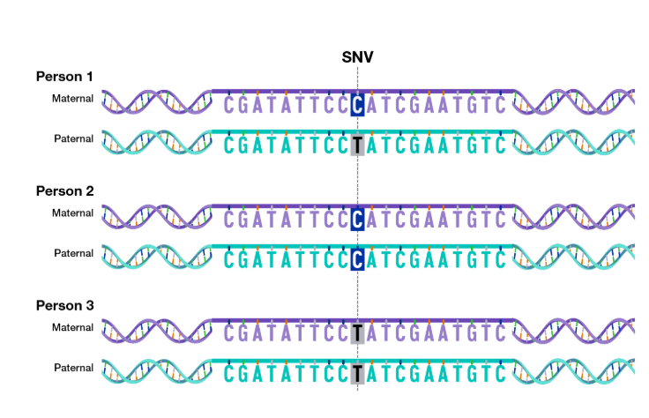

Single nucleotide variants (SNV or SNP)
Reference:
Source: genome.gov

Slide 13
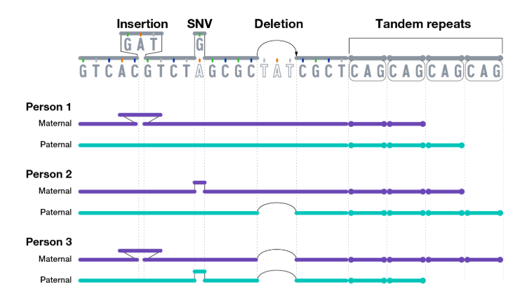
Other variants
Source: genome.gov

Slide 14
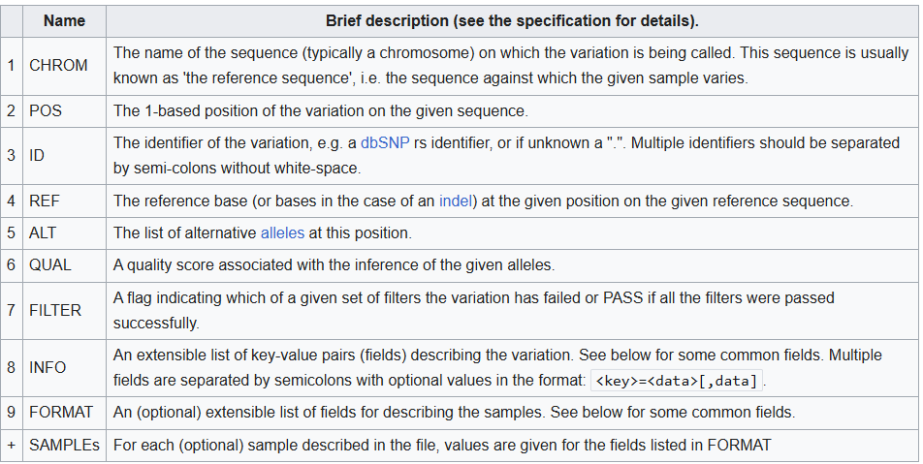
VCF file format
Variant calls are usually reported in VCF format:

Slide 15
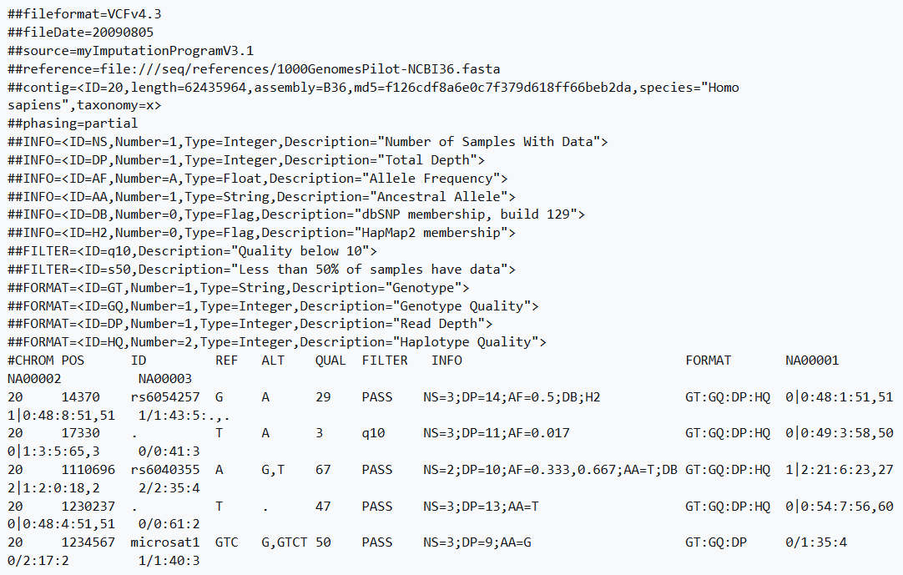
VCF file format: example

Slide 16
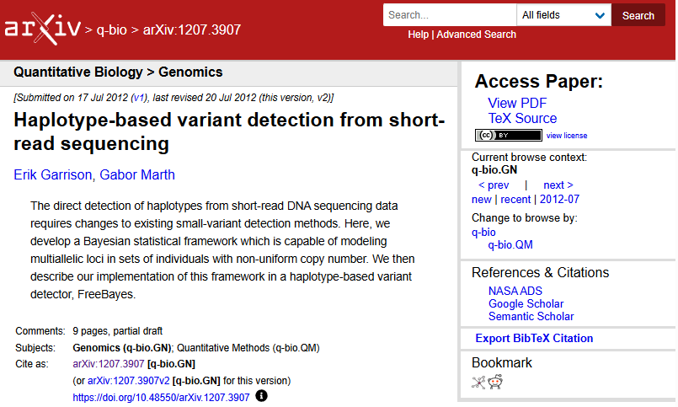
Variant calling software
I recommend freebayes – it works very well, very stable and easy to install (static executable)
Other programs:
  GATK
  Google’s deepvariant
  Strelka2
  Octopus

Slide 17
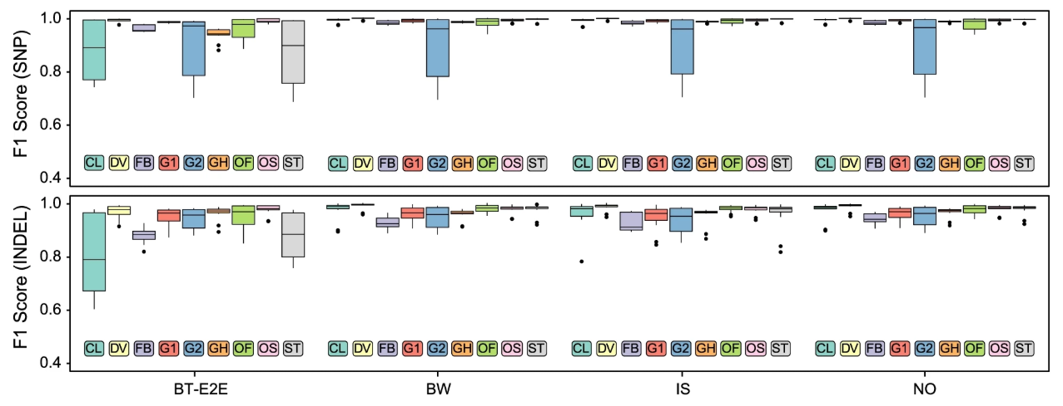
Performance of variant callers
Deepvariant is the most expensive to run and performs best. Overall differences are small(Barbitoff et al, 2022):

Slide 18
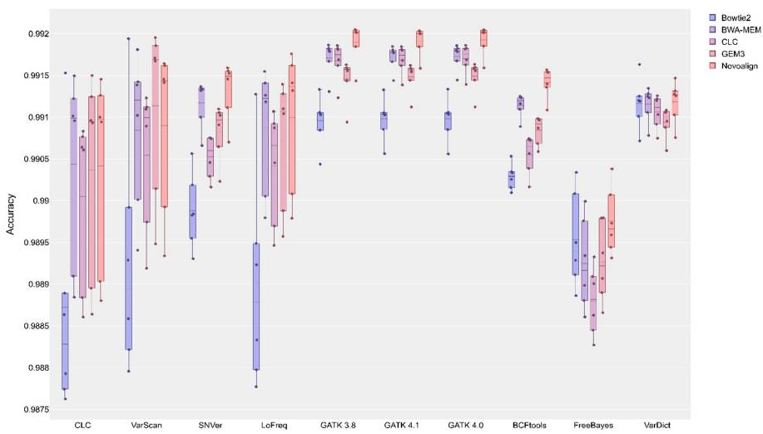

Performance of variant callers
Another comparison—note the Y axis scale (Barbitoff et al, 2022):
Look at the vertical scale: very little difference between programs!!!

Slide 19
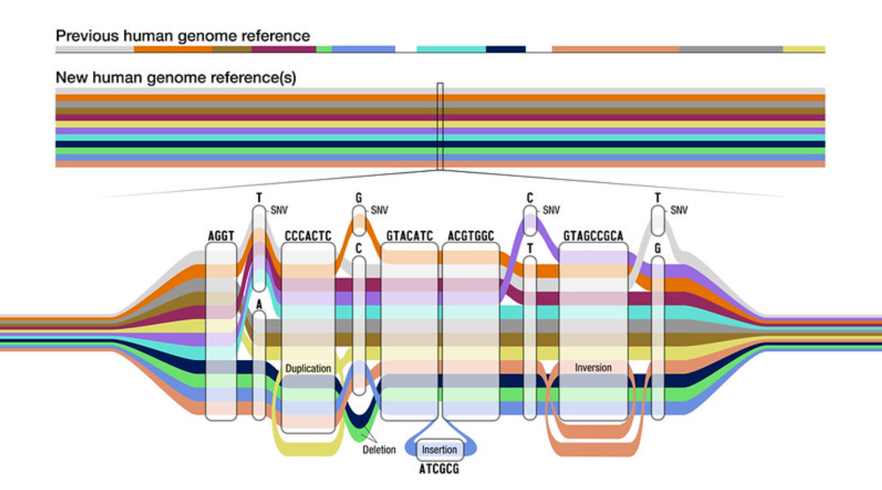
Variant calling: Problems
Source: nhgri.gov
Repeat regions and errors in the reads may lead to incorrect or missing alignments
Individual genomes differ (mostly in repetitive sequences): reads from individual A and B that came from sequences not present in the reference genome may align (poorly) to another place in the reference, thus contributing to spurious variant calls
  Solution: pangenome, align reads to multiple genomes, use the best alignment
  Human Pangenome Reference Consortium (HPRC) https://humanpangenome.org/

